Slide 1
Reintegration and Rehabilitation
Sri Lanka

Slide 2
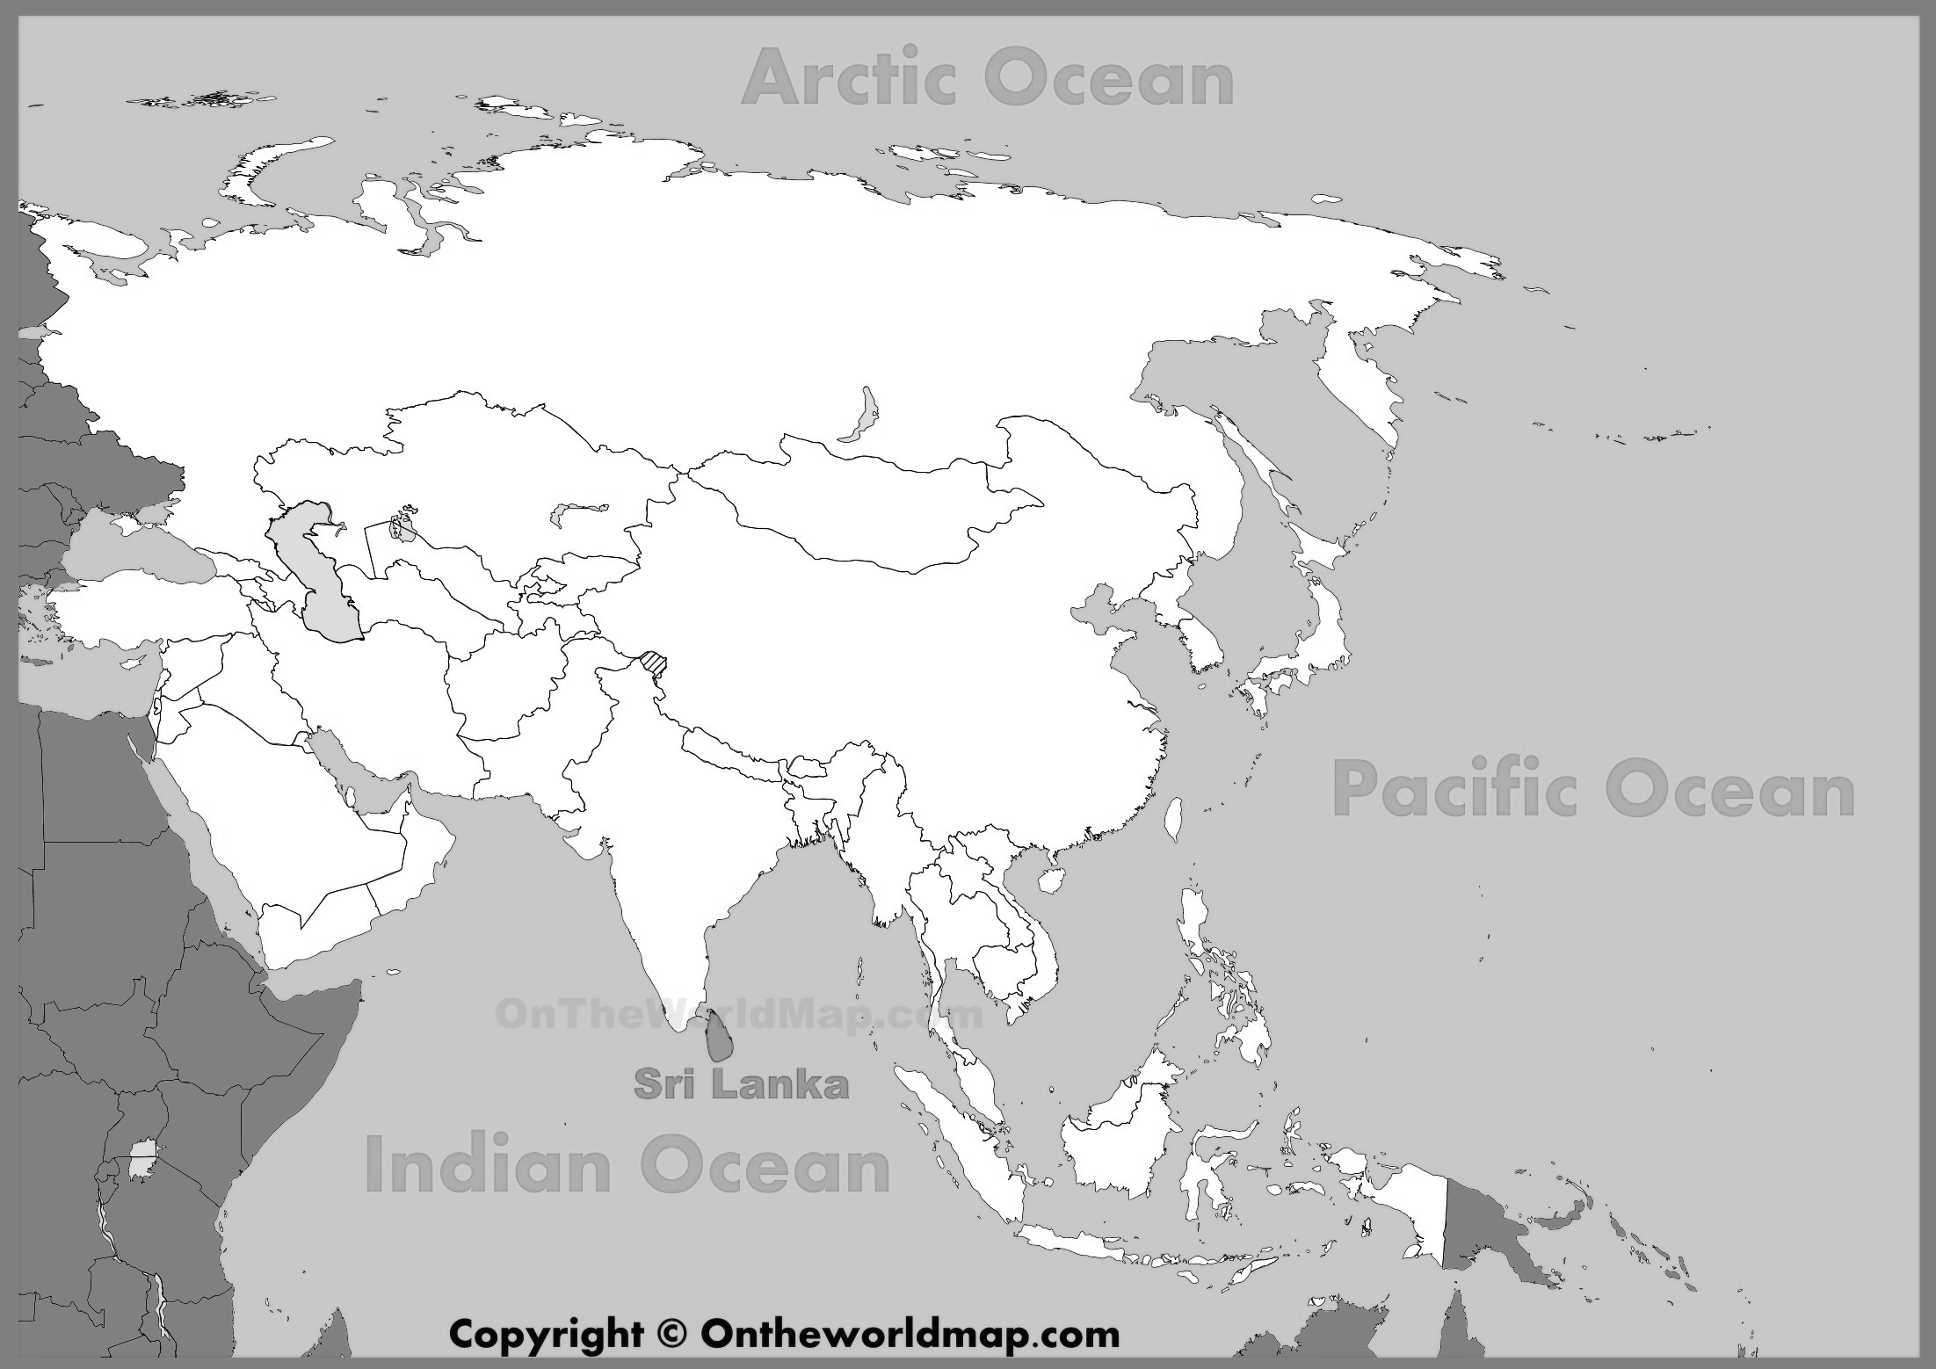

Background | Model | Comparison | Learnings
Sri Lanka

Slide 3
Background | Model | Comparison | Learnings

Slide 4
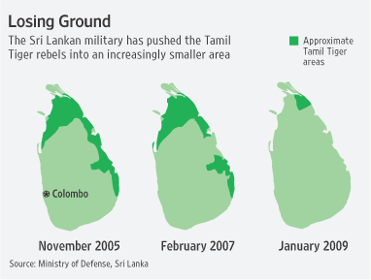
Background | Model | Comparison | Learnings
Beginning
of Civil War
Sri Lanka declares victory
End of Civil War
July 1983
May 2009
1958
1970s
1987
2002
25+ Years of War
Sinhala Only Act
First LTTE Suicide Attack
Temporary
Peace Talks
Standardization Policy
2002
2007
2009
Notes:
I point out the first suicide attack here, because the Black Tigers, the LTTE suicide bombing force is widely acknowledged to have invented the suicide jacket and perfected the art of suicide bombing (National Framework Proposal for Reintegration, Sri Lanka)

Slide 5
Background | Model | Comparison | Learnings
Sri Lanka declares victory
End of Civil War
May 2009
PARCs Functional
Jul 2009
2010
Oct 2009
National
Reintegration
Strategy
Lessons Learnt Commission

Slide 6
Background | Model | Comparison | Learnings
Economic Reintegration

Slide 7
Background | Model | Comparison | Learnings
PARCs
Water
Counselling
Sanitation
Training
Food, Nutrition
Notes:
PARC = Protective Accommodation and Rehabilitation Center

Slide 8
Background | Model | Comparison | Learnings
PARCs
Vocational and Skills Development
Profiling
Value and Moral Training
Notes:
PARC = Protective Accommodation and Rehabilitation Center

Slide 9
Background | Model | Comparison | Learnings
Transitional Justice
“…the granting of amnesties in appropriate cases to perpetrators of egregious human rights violations is most likely not precluded by international law.”
National Framework Proposal for Reintegration of Ex-Combatants into Civilian life in Sri Lanka

Slide 10
Background | Model | Comparison | Learnings
Sri Lanka
Nigeria

